Slide 1

Housing Choice Voucher Program
Briefing Session
Welcome
Fort Worth Housing Solutions
Presents
www.fwhs.org
Revised March 24, 2022

Slide 2

Please take this time
to check your electronic device. It will be used to show you how to access our website www.fwhs.org to locate vital information

Slide 3
Briefing Purpose:
To cover HCVP rules.
To provide suggestions for housing.
To issue your voucher.
When you leave the briefing today, you may officially go and search
for a place to live.

Slide 4
What is the Housing Choice Voucher Program (HCVP)?
The definition of the Housing Choice Voucher Program (HCVP) is a Federal housing/rental assistance program in which housing assistance payments are paid directly to private owners who lease their rental units to eligible HCVP voucher holders.

Slide 5

Fair Housing Act
By law you cannot be discriminated against due to the following:
Race/Color
National Origin
Religion
Gender
Marital Status
Handicap/Disability
Sexual Orientation

Slide 6
Screening and Eviction for Drug Abuse and other Criminal Activity (SEDACA) Policy Overview
FWHS shall pursue reports or complaints from a landlord, neighbor, or the general-public regarding drug-related or criminal activity where a Housing Choice Voucher Program participant is housed.
The agency shall enforce this SEDACA policy with “zero tolerance”.
Evidence of such activity shall be grounds for immediate termination of Housing Choice Voucher Program assistance.
Applies to everyone in the household aged 18 and older, including family and friends.
There does not have to be a conviction.

Slide 7

What HCVP Provides to You as a Client
Program Contact Phone #
Family Self-Sufficiency (FSS) Markesha Thomas (817) 333-3607
Workforce Coordinator Jerome Johnson (682) 703-2284
Homeownership Deana Broussard (817) 333-3653

Slide 8
Violence Against Women Act (VAWA)
THE FOLLOWING ARE VARIOUS TYPES OF VIOLENT ACTS AGAINST WOMEN AND MEN:
Domestic Violence
Dating Violence
Stalking
Sexual Assault
The Housing Choice Voucher Program selection/admissions and continued occupancy provisions prohibit denial of selection/admission or eviction/termination of assistance to individuals for reasons related to incidents of domestic violence in which they were a victim. (Sections 606 and 607).

Slide 9
Resources
Resources
Safe Haven of Tarrant County:
24-hour crisis hotline: 877-701-7233
website: www.safehaventc.org
The Women's Center:
24-hour rape crisis hotline: 817-927-2737
nonemergency hotline: 817-927-4039
website: www.womenscenter.info
Tarrant County District Attorney Family Violence Unit: 817-884-3535
One Safe Place
Main Line: 817-916-4323
website: www.onesafeplace.org

Slide 10
Lead-Based Paint Information
Lead-Based Paint Information
Many houses and apartments built before 1978 have paint that contains high levels of lead (called lead-based paint).
Important Facts About Lead-Based Paint:
Lead exposure can harm young children and babies even before they are born.
Even children who seem healthy can have high levels of lead in their bodies.
People can get lead in their bodies by breathing or swallowing lead dust, or by eating soil or paint chips containing lead.
People have many options for reducing lead hazards. (In most cases, lead-based paint that is in good condition is not a hazard.)
Removing lead-based paint improperly can increase the danger to your family.
Reference: Protect Your Family From Lead In Your Home ; EPA/USCPSC/USDHUD

Slide 11
How Your Rent is Calculated
You will pay 30% of your adjusted income for rent and utilities.
EXAMPLE:
Income: $10.00 x 40 = 400 x 52 = $20,800
$20,800 / 12 = 1733.33 x 30% = $520
Total Tenant Payment (TTP) = $520
Utility Allowance (UA) = $117 (TTP 520 – 117 UA = 403)
Tenant Rent = $403

Slide 12
Deduction for Household
$480 for each dependent.
$400 for any elderly or disabled household (Head of household, or spouse or co-head of household, 62 years of age or older or a person with disabilities).
$480 deduction for a full-time student who is over the age of 18.
Any reasonable childcare.
Unreimbursed medical expenses for any elderly or disabled family.
Unreimbursed care, attendant and/or auxiliary apparatus expenses for a member of the family with a disability, needed to permit an adult family member to work.

Slide 13
Income Deduction Example
EXAMPLE:
Income: $10.00 x 40 x 52 = $20,800
Dependent Deduction: - $480 = $20,320
$20,320 / 12 x 30% = $508
Total Tenant Payment (TTP) = $508
Utility Allowance (UA) = $117 (508 -117 = 391)
Tenant Rent = $391

Slide 14
Reporting Changes to Household Income
All changes in Household Income & Family Composition MUST be reported to Fort Worth Housing Solutions within 10 DAYS of the change. All changes must be submitted IN WRITING. Go to website www.fwhs.org, click on forms and locate Notice of Change Form. Complete and submit with supportive documentation.
Income:
Decrease will be effective the first of the following month from the date of the change.
Increase will go in to effective 30 days from the date of the change.
You should always keep documentation of the change you submit.

Slide 15
Income
Income is anything that comes into your household on a regular basis to support you and your family.
Examples of Income Sources
Family Contributions: All other contributions to household (someone buys diapers for children, etc.)
TANF
Employment
VA Benefits
Social Security Benefits
Bills paid by others (cell phone, utilities, etc.)
Self-Employment

Slide 16
Reporting Income Increase/Decrease
Remember, when reporting any change to your household income, whether it is an increase or decrease:
Continue to pay the original rent amount until you receive a letter from Fort Worth Housing Solutions (FWHS) stating the new rent amount.

Slide 17
Household Obligations
Notify FWHS in writing of the birth, adoption, or court-awarded custody of a child or move out of any family members within ten (10) days of the occurrence.
This can be done electronically at hcvchanges@fwhs.org
To add any family member or person to my application or add them to my lease, I MUST REQUEST
APPROVAL BY FWHS IN WRITING AND RECEIVE WRITTEN APPROVAL BY FWHS PRIOR TO THEM MOVING IN. I MUST RECEIVE WRITTEN APPROVAL FROM THE LANDLORD AND NEW LEASE OF THE PERSON BEING ADDED.
This can be done electronically at hcvchanges@fwhs.org
My dwelling unit may only be used as the sole residence for my family as listed on my application.

Slide 18
Adding/Removing Household Members
How Do I Add/Remove Household Members?
In order to add someone to your household, you must get written permission from FWHS and Landlord.
This can be done electronically at hcvchanges@fwhs.org
Background checks will be completed on all household members age18 and older who will be added to the household.
If adding additional minors to the household, court-ordered documents, guardianship or CPS documents, etc. must be submitted, as required by the agency.
This can be done electronically at hcvchanges@fwhs.org

Slide 19
Unauthorized Occupants
NO UNAUTHORIZED OCCUPANTS ALLOWED
No one may reside in your unit or use your mailing address unless they are listed on your application with Fort Worth Housing Solutions.

Slide 20
Annual Recertification Requirements
I must provide FWHS with all information requested to complete my annual or interim recertification.
Failure to complete any annual or required interim recertification may result in the withdrawal of my housing assistance.

Slide 21
I Will Lose My Assistance and Criminal Charges Could Be Filed If:
You own or have any interest in your dwelling unit.
You commit fraud, bribery, or any other corrupt or criminal act in connection with the program.
You fail to provide all information that is true and complete.
You sublease, or let the unit or lease be assigned to someone else.
You receive Housing Choice Voucher assistance while receiving any other housing, from a FEDERAL, STATE, or LOCAL assistance program.
You provide Fort Worth Housing Solutions with falsified or altered documents.

Slide 22

Reporting Fraud
  You may report fraudulent activity anonymously to the Fort Worth Housing Solutions.
  (817) 333-3404 or fraud@fwhs.org

Slide 23
Informal Hearings
You may request an Informal Hearing if you receive a withdrawal letter from FWHS.
When you request an Informal Hearing:
Do not move out of the unit.
Do not stop paying your rent.
Wait for your hearing to determine any changes in your housing.

Slide 24
Condition of Unit
You must maintain the condition of your dwelling unit to meet annual Housing Quality Standards (HQS) requirements.
You may be charged by the landlord for any damages to the unit that are caused either by you, your family, or guests to the unit.

Slide 25

Abatement
Never stop paying your rent!
You are not responsible for paying FWHS portion of rent!
Even if repairs need to be done to your unit

Slide 26
Relocation
Approval by FWHS to relocate is contingent upon the following:
Not being evicted due to lease violations.
Having made restitution for any tenant-related damages for which you are responsible for.
Having provided appropriate notice to your landlord of your intent to terminate your lease.

Slide 27


Relocation
You have ten (10) business days from the date of your annual recertification letter to request to relocate, in writing.
***Never move before your relocation process is approved!***

Slide 28
Relocation
The unit you select must PASS HQS inspection, and must PASS A RENT REASONABLE TEST before FWHS gives approval of the unit and activation of the contract.
If you choose to move into a unit prior to receiving approval from FWHS, you will be responsible for all monies owed to the landlord.

Slide 29
How To Find A Place
Affordable Housing: An online property listing service provided by FWHS but not managed by FWHS. Access the service at www.affordablehousing.com (Visit our website www.fwhs.org for a list of our properties).
FWHS clients are not limited to Affordable Housing.com: You are encouraged to check newspaper ads, ask friends and family, and look for “FOR RENT” signs in front of houses and/or apartments.

Slide 30
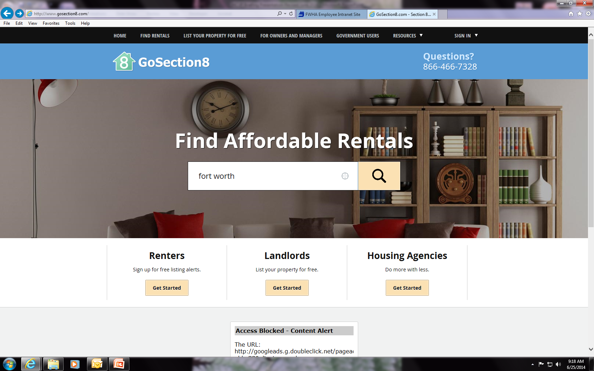
Affordable Housing (formerly Go Section 8) www.affordablehousing.com
Click on “Find Rentals”

Slide 31
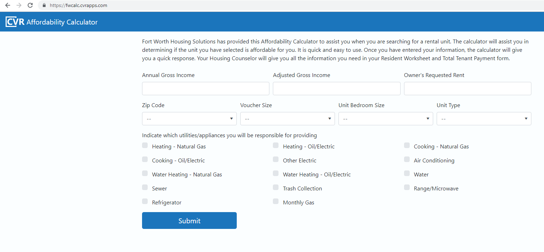
Affordability Calculator
https://fwcalc.cvrapps.com/
This calculator will allow you to quickly figure out if you can afford the housing unit you have selected.
Your housing counselor will give you the forms that contain the information you’ll need for the calculator. The forms are: Your Resident Worksheet, TTP form, Payment Standards and Utility Allowance chart.

Slide 32
RFTA FORM
Request For Tenancy Approval
Landlord and potential tenant must complete and sign the form, which must include but not limited to the following:
  The CORRECT address of the assisted unit
  The date the unit will be ready for inspection
  The contract rent for the assisted unit
  You must turn in a Request For Tenancy Approval (RFTA) on a unit which meets Housing Quality Standards (HQS) within the 60-day period.
The RFTA may be returned to FWHS via email at rfta@fwhs.org or dropped or mailed to our office at 1407 Texas Street, F.W.TX 76102
The RFTA must be submitted prior to the expiration of the Housing Choice Voucher

Slide 33
Security Deposit Tips
You are responsible for paying the Security Deposit
$
If the landlord allows you to pay on a monthly basis until paid in full, please make sure you fulfill your obligations.

Slide 34



REQUEST FOR TENANCY APPROVAL
RFTA FORM
-List the full correct address of the unit
-Specify who will be responsible for utilities, as well as the stove and refrigerator
-State the date the unit will be ready for inspection
-Landlord/Tenant, please follow up with the lease up team for status of your RFTA after submission please allow them to verify if tenant qualifies for unit, if tenant does qualify an Inspector will follow up with landlord to schedule an initial inspection 48 hours after receiving completed packet.
LEASE UP TEAM: Leaseupteam@fwhs.org
To be completed
By landlord
To be completed
By Tenant

Slide 35
Your Voucher
Once you are issued a voucher, you have 60 calendar days to locate a unit that will fit your family’s needs.
If you are in need of an extension. Please visit our website, www.fwhs.org, click on Housing Programs, Forms, and locate Voucher Extension Request. Complete and send it to the email address on the form.
Remember you have every right to request an extension in writing, however, it is not guaranteed the extension will be granted. Your ultimate goal is to obtain a unit and lease up within the time frame of your voucher issuance and expiration date

Slide 36
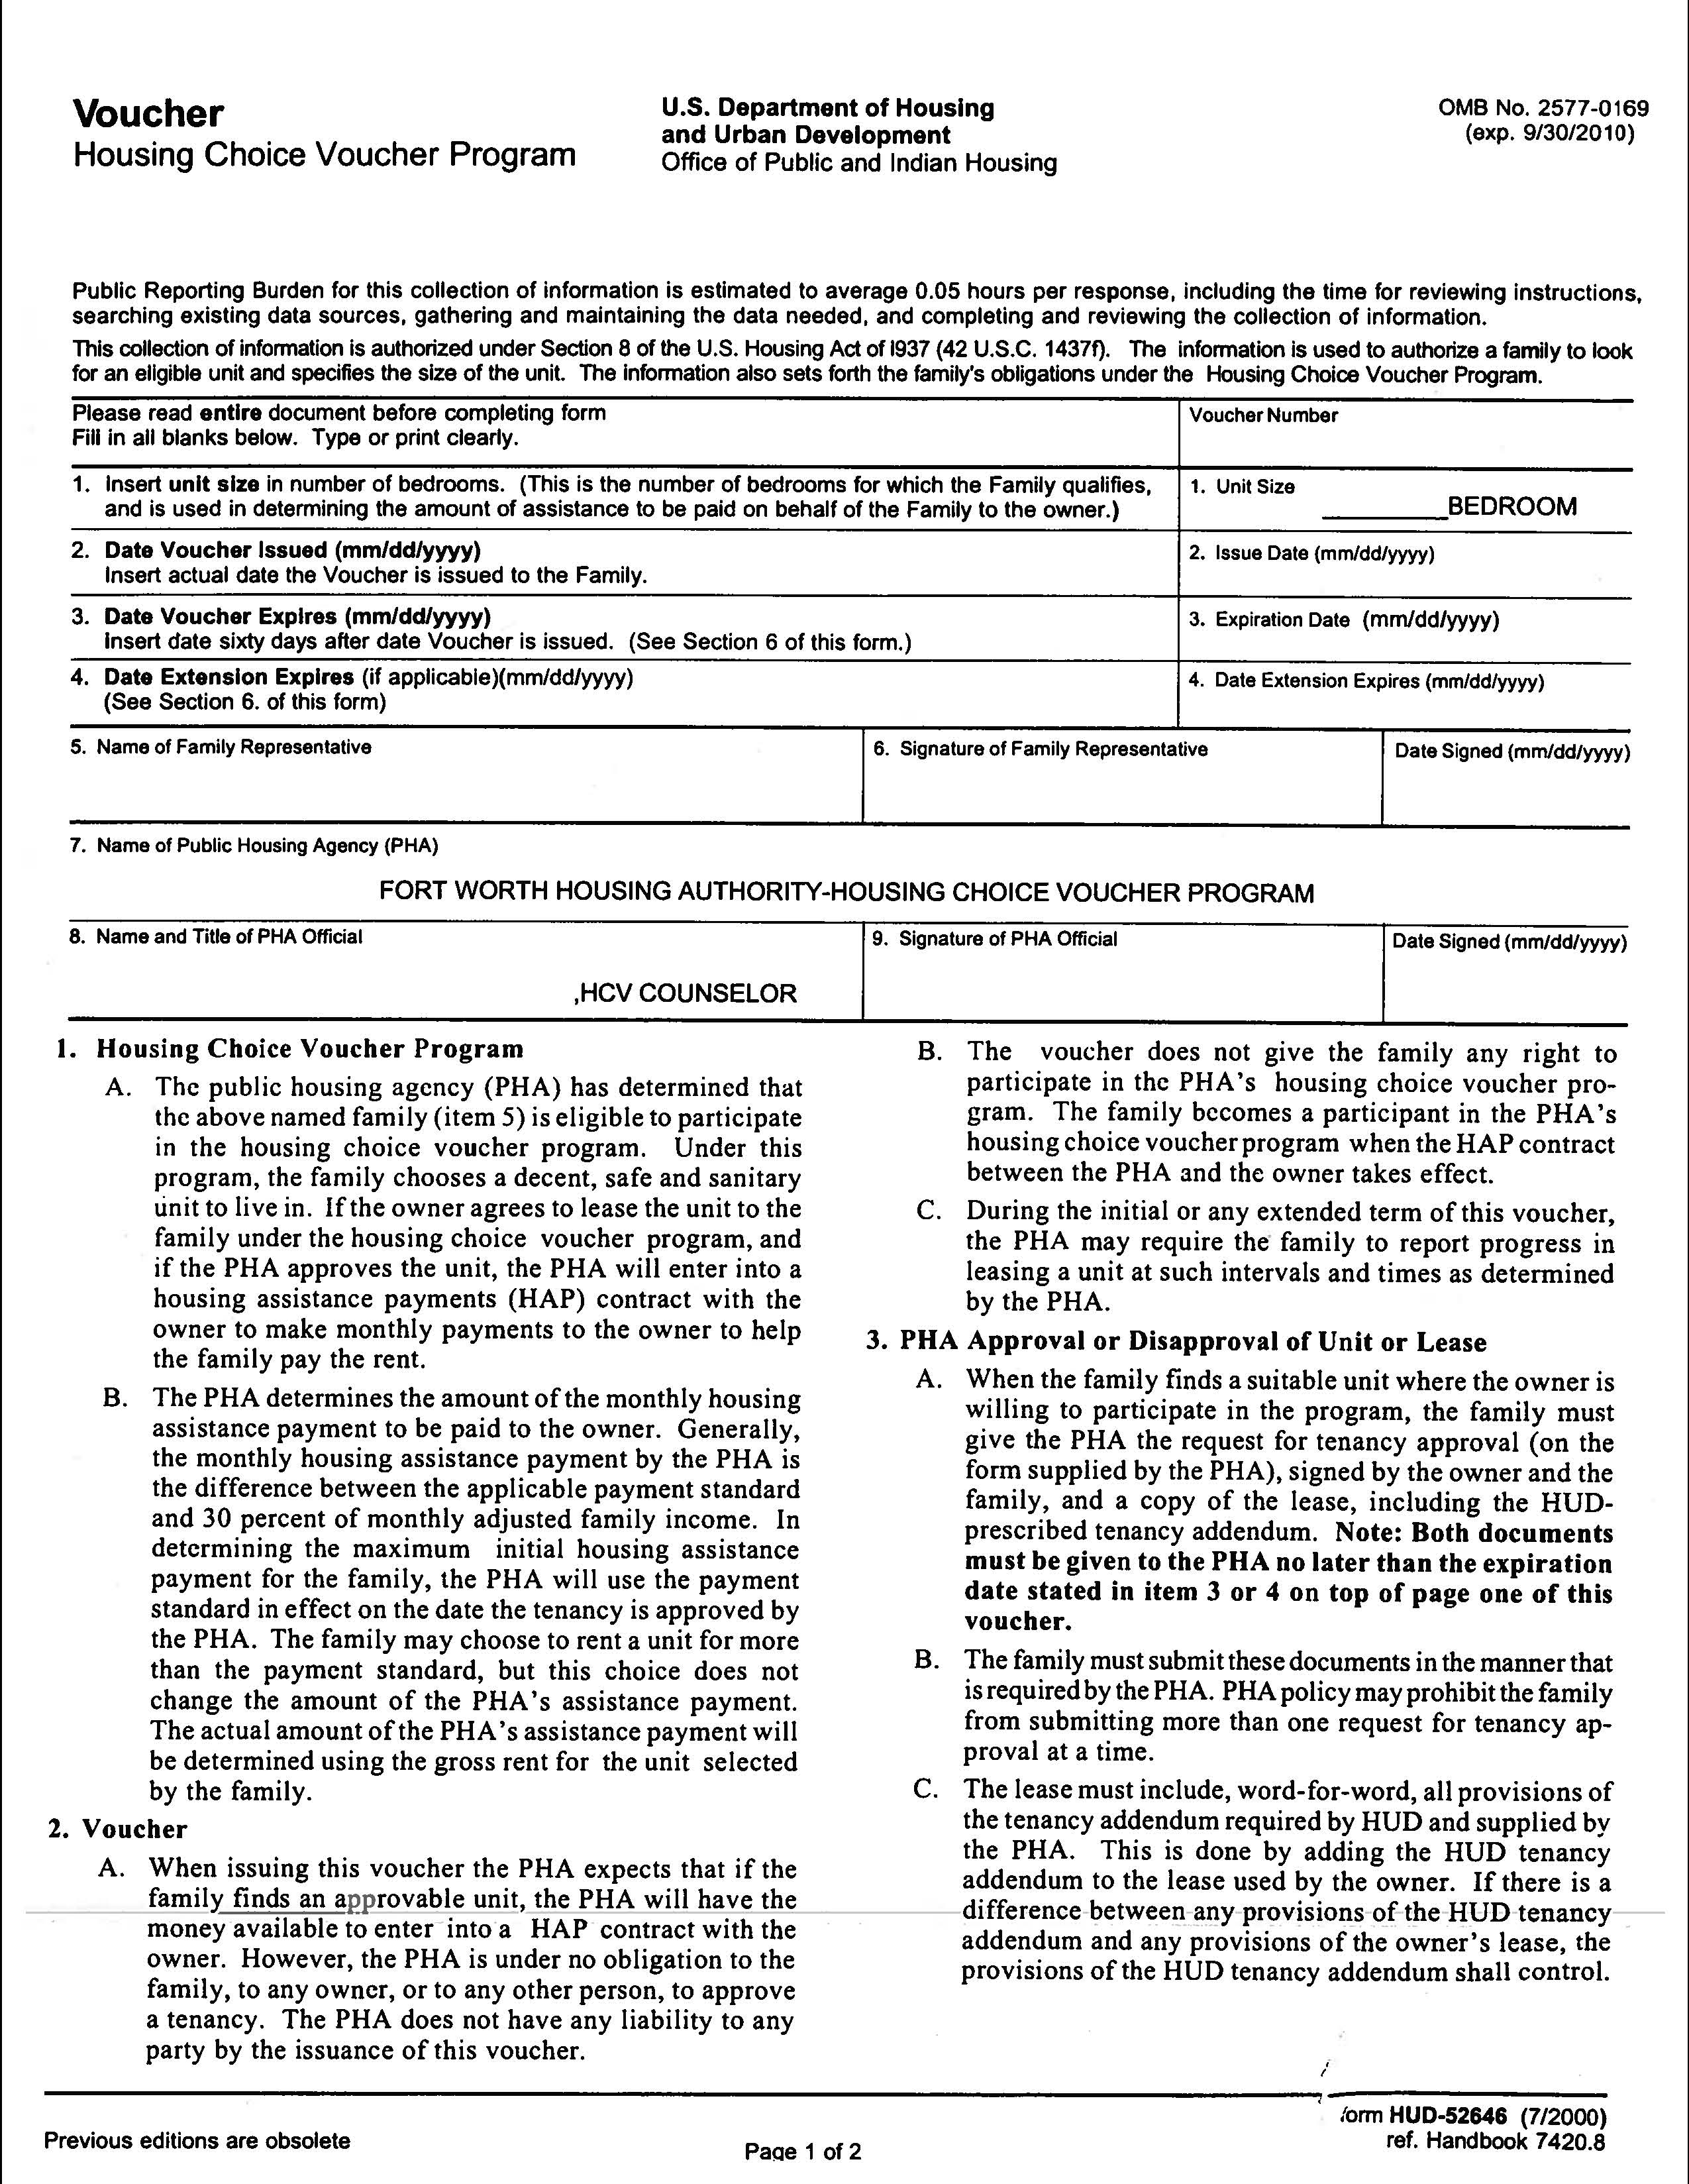
Your Voucher
Please note:
The word
“Voucher” is printed
on the upper
left-hand area of the
voucher form.

Slide 37
Unit Size
Certified according to family size.
Get a larger size if rent is below your certified amount.
Get a smaller size if your family can live comfortably in a smaller unit for at least 1 year (will go by lower rent limit).

Slide 38
Year Payment Standard
Example
payment standards per zip code
ZIP Code 0 BDRM 1 BDRM 2 BDRM 3 BDRM 4 BDRM 5 BDRM 6 BDRM
75050 $990 $1,090 $1,310 $1,700 $2,220 $2,553 $2,886
75051 $860 $950 $1,140 $1,480 $1,940 $2,231 $2,522
75052 $1,120 $1,250 $1,500 $1,960 $2,550 $2,933 $3,315
75053 $950 $1,060 $1,270 $1,660 $2,150 $2,473 $2,795
75054 $1,350 $1,530 $1,860 $2,490 $3,110 $3,577 $4,043
76008 $1,220 $1,380 $1,680 $2,250 $2,810 $3,232 $3,653
76009 $850 $960 $1,170 $1,570 $1,960 $2,254 $2,548
76013 $830 $950 $1,150 $1,540 $1,920 $2,208 $2,496
76020 $790 $900 $1,090 $1,450 $1,810 $2,082 $2,353
76021 $1,020 $1,160 $1,410 $1,890 $2,360 $2,714 $3,068
76022 $940 $1,070 $1,300 $1,740 $2,170 $2,496 $2,821
76028 $960 $1,090 $1,320 $1,770 $2,210 $2,542 $2,873

Slide 39
Utilities
If utilities are not included in your rent, you must have an account in the head of household/spouse’s name only.
  Utilities must be on at all times .
  Maintain current payments of utilities after move in.
  If utilities are disconnected, you will only have 48 hours to restore service.

Slide 40
Utility Allowance
Utility Allowance (UA) is determined by what utilities you are required to pay.
UA is a discount deducted from the tenant’s portion of rent.
UA will not cover the entire bill but is meant to help.

Slide 41
Utility Allowance Chart (in packet)
Breakdown of Monthly Dollar Allowances for various types of utilities
Total Utility Allowance for the unit

Slide 42

Obtaining Landlord Approval
Present yourself in a positive manner.
Complete application truthfully and completely.
Pay Fees.
Landlord checks credit history, criminal record & rental history.
Pay Security Deposit.

Slide 43
Avoid Scams and Fraud
Never give out financial information to anyone who calls you over the phone.(Example: bank account number, social security number, PayPal info, ect.)
AffordableHousing.com does not store credit card nor will we ever ask for your social security number. Tenants will never receive a phone call from affordablehousing.com.
Tenants should always deal locally with landlords and property managers that you can meet in person. Wiring funds to an unknown individual should never be done.
It is important to contact the appraiser/assessor office to verify the landlord is the owner of the property.
If in doubt as to ownership or the representation of an agent, we recommend you check with the local housing agency, landlord liaison before exchanging any funds.

Slide 44
The Fort Worth Housing Solutions Move Process
The following slides illustrate the entire Move Process of FWHS:
Participant submits notice to landlord in accordance to lease required time frame (FWHS recommends a 60-day notice); Provide Housing Counselor with a copy of the notice.
Landlord is required to provide Housing Counselor a completed Affidavit of Damages/Unpaid Rent form (download form from landlord forms), confirming receipt of notification that states if participant is in good standing with any payments owed and no damage done to property (FWHS suggests landlord conduct an inspection before submitting letter). Participant and landlord must BOTH sign the form.
Once both required documents have been received, the participant will be notified in writing of an appointment to attend a voucher briefing. Participant should be prepared to bring current income verification information and the complete updated Tenant Information package.

Slide 45
The Move Process
Participant will be issued a relocation voucher along with moving package to include information on how to access affordablehousing.com for current property listings.
Once participant has found housing of choice, the landlord must complete
Request for Tenancy Approval (RFTA) form in its entirety and submit all required
landlord documentation.
Once all documents are completed they should be submitted to the Housing
Choice Voucher department for processing. Staff will process unit affordability to
ensure that participant is not paying more than 30% of annual adjusted income.
If unit is affordable, participant and landlord will be contacted to inform them
of that information and to provide an estimated Housing Assistance Payment
(HAP) and estimated rent portion.

Slide 46
The Move Process
If unit is not affordable, landlord and participant
will be contacted by FWHS to see if landlord is willing to lower proposed rent to an affordable amount.
**PARTICIPANT SHOULD NOT MOVE IN AT THIS TIME OR SIGN A LEASE**
If the landlord agrees to lower proposed rent to make unit affordable, the landlord will be required to submit in writing the agreement to lower rent to include unit address, new rental amount and participant’s name.
If the landlord does not agree to lower proposed rent, participant will be mailed or emailed a new RFTA.
Affordable unit will be submitted to inspection team. Inspection team member will contact landlord to schedule time and date for Housing Quality Standards Inspection.

Slide 47

Inspection Process
Once approved by the landlord as a new tenant, have the landlord complete the Request for Tenancy Approval (RFTA) and submit it.
You may submit by email:
Email: RFTA@fwhs.org
Any questions regarding the RFTA, inspection, or unit you may email inspections@fwhs.org or call 817-333-3652

Slide 48
Inspection Process (continued)
Inspector schedules inspection with landlord and determines reasonable rent.
Rent must be reasonable – priced right for what it offers (location, condition, etc.).
If the unit does not pass inspection, the inspector will coordinate with the owner to do a second inspection.
If there are repairs and they are too extensive or rent is not reasonable, you will be asked to find another place.

Slide 49
Inspection Process (continued)
DO NOT move into the unit until it
has passed HQS Inspection
If you do move into the unit before it has
passed inspection, you will be responsible
for paying the rent until the unit passes inspection.

Slide 50
The Move Process
Passed Inspection
Inspector will complete inspection paperwork and fair market rental comparisons will be completed to ensure fair market rent is being charged. If unit is rent reasonable, the inspection team will provide final documents to the Contracts Clerk who will then contact the landlord and participant to arrange lease start date and lease end date.
Participant may move in based on the effective lease date
** Note: Lease dates, contract rental amount and HAP contract dates and contract rent must coincide. **

Slide 51
The Move Process
Failed Inspection
Inspector will notify landlord of deficiencies. The inspector will provide landlord with a proper time frame to correct deficiencies depending on what is required to be corrected.

Slide 52
Move Process Summary
Do not move in until your landlord receives your move-in approval letter from FWHS Inspections Department.
You will pay the landlord your portion of the rent (Total Tenant Payment Amount).
You will pay a prorated amount for the first month, if not moving in on the 1st.

Slide 53
The Move Process
Final Steps in Move Process:
FWHS will process HAP contract and contact landlord and participant informing them of the HAP portion and participant portion, if any.
HAP contract will be sent to landlord for review and signature. HAP contract should be read, signed and returned along with a copy of signed lease.

Slide 54
Voucher Extensions
Requests to extend voucher MUST be
in writing. Go to our website, www.fwhs.org click on forms and locate Voucher Extension Request. Complete and submit to email address listed at the top of the form hcvchanges@fwhs.org

Slide 55
FWHS Jurisdiction
Location must be within FWHS jurisdiction
Examples of Covered Areas | Non-Covered Areas
Fort Worth | Dallas
Hurst/Euless/Bedford | Arlington
Keller/Saginaw | McKinney
White Settlement/ Lake Worth | Irving
Crowley | Weatherford
Everman | Denton
Forest Hill/Grand Prairie | Plano

Slide 56
Portability
You may choose to relocate out of the Fort Worth Housing Solutions jurisdiction to any other housing authority in the United States and its territories which also offers the Housing Choice Voucher Program.
The following are requirements for portability:
Must have a legal residence or work in Fort Worth’s jurisdiction at the time of application.
OR
Must be a current participant in the HCV Program in good standing and have completed the initial twelve month contract with no outstanding debt to the landlord.

Slide 57
Location, Location, Location!
Minority non-impacted areas | Poverty non-impacted areas
when looking for a place, try to find areas with a variety of ethnicities/races | Highly encouraged not to choose an area with a high poverty rate: this includes areas affected by crime, violence, drugs, etc.
MAKE SURE YOU CHECK OUT THE AREA BEFORE ATTEMPTING TO MOVE IN
Note: If you are unsure about an area…
Go check it out at night and see what type of activity takes place in this area, if any. Once you commit to signing a lease you cannot break the contract.

Slide 58
Voucher Mobility
  What is voucher mobility?
  The ability to use your voucher in low- poverty areas with economic and educational opportunities.
  Why does it matter?
  Studies show improved health and academic performance in children who move to low- poverty areas.

Slide 59
Voucher Mobility
Why does it matter? (cont’d)
High opportunity areas offer more and better employment opportunities, as well as better schools and safer environments.
How can I find a home in a high opportunity area?
By researching your future home and its location at:
www.opportunitymoves.org – is a website to locate housing in High Opportunity Areas and homes in Walkability Areas.
www.ffiec.gov/geocode - is a website that tells you the poverty rate of census tracts by address.
www.fortworthpd.com – is the website for the Fort Worth Police Department; you may look at crime reports by address.
www.tea.state.tx.us – is the website of the Texas Education Agency, which gives school rankings by districts and individual schools.

Slide 60

www.opportunitymoves.org

Slide 61
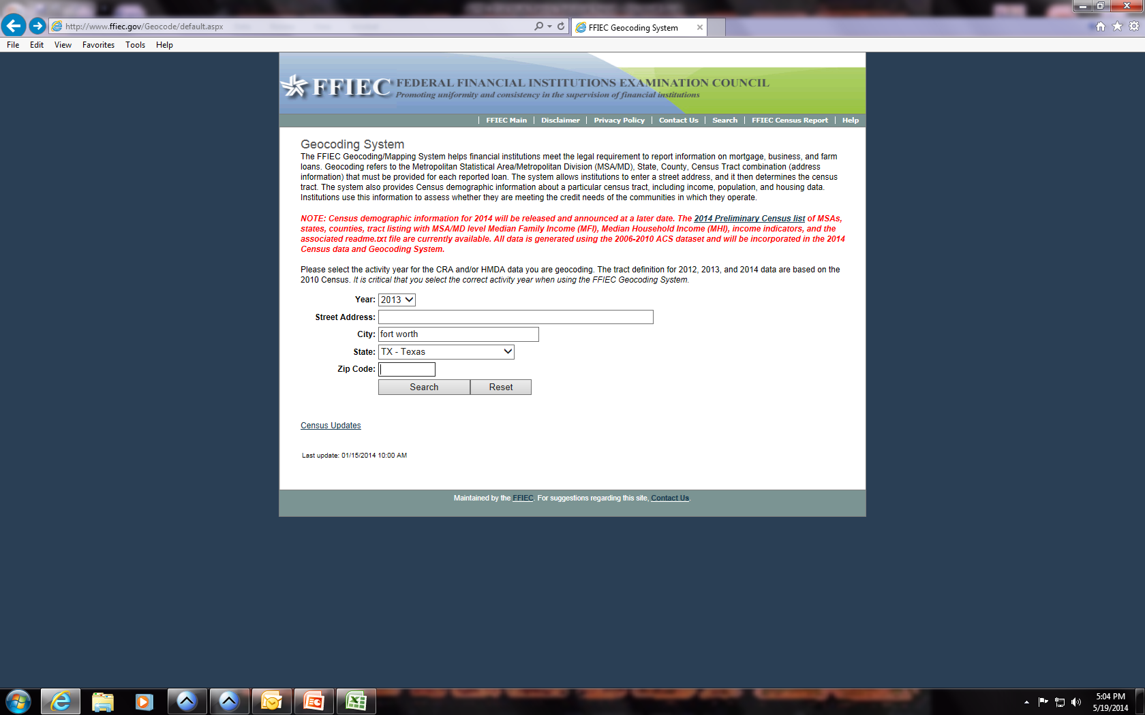
www.ffiec.gov/geocode (Use most recent year)
Enter full address of unit and click SEARCH

Slide 62
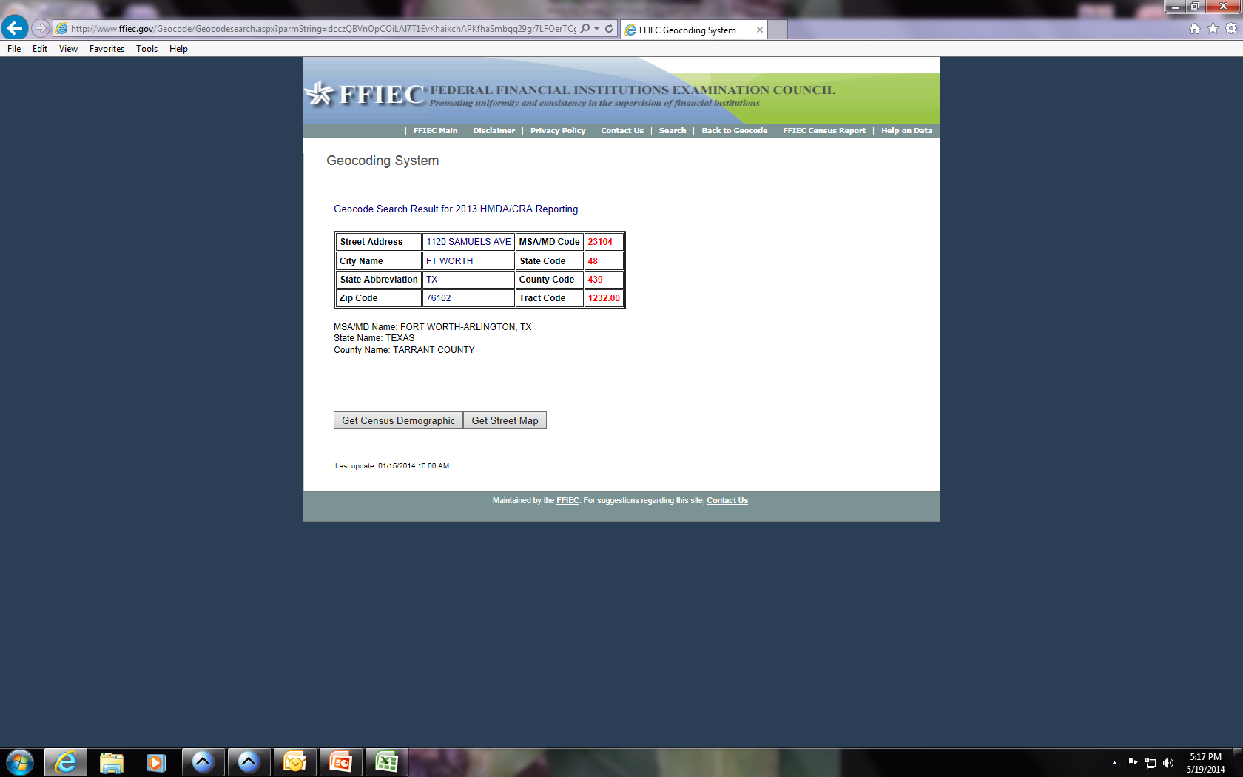
Click GET CENSUS DEMOGRAPHIC

Slide 63
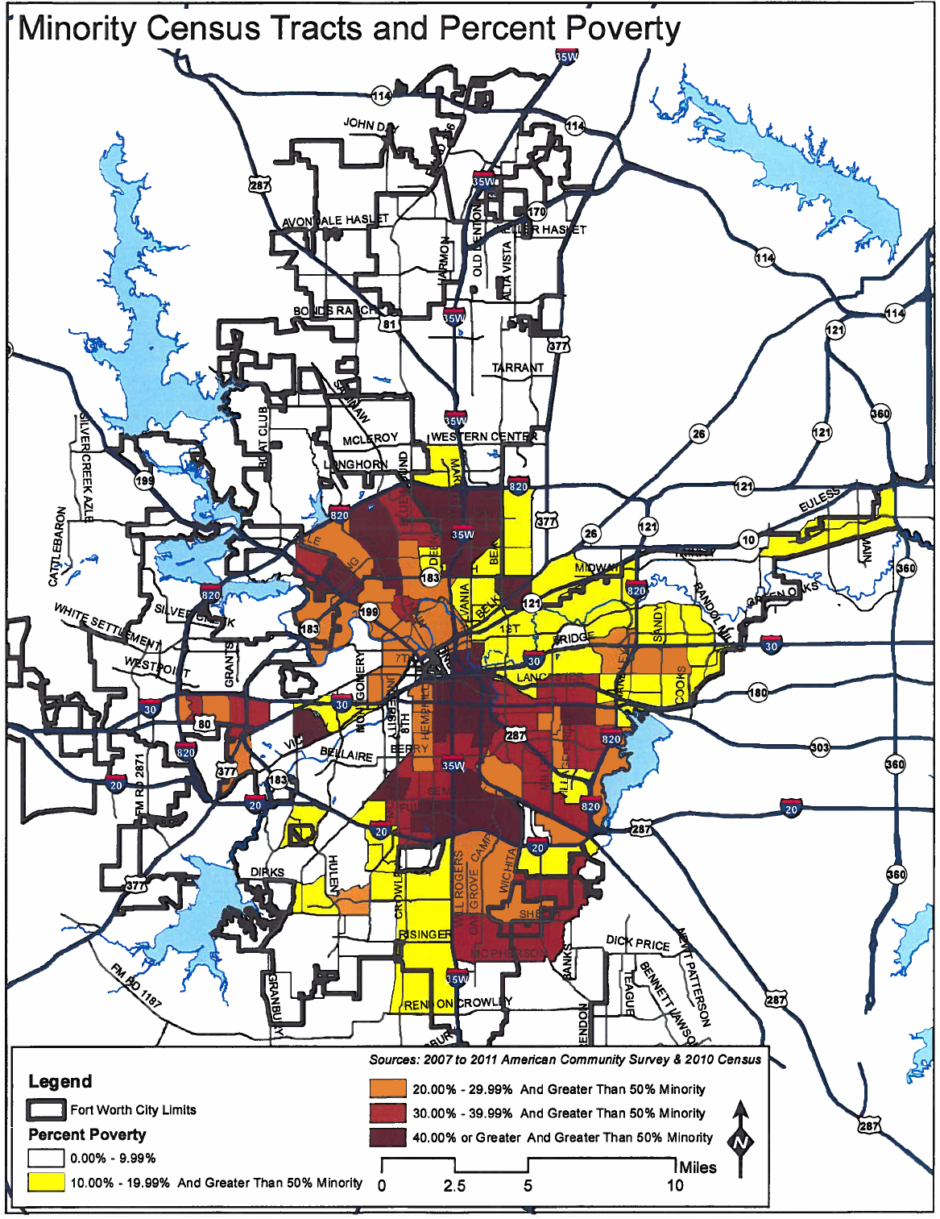
Census Data Map
This map details the poverty
percentage of areas within the
Jurisdiction of FWHS
Fort Worth City Limits
Percent Poverty:
0.00% - 9.99%
10.00% - 19.99% And
greater than 50% Minority
20.00% - 29.99% And Greater
Than 50% Minority
30.00% - 39.99% And Greater
Than 50% Minority
40.00 % or Greater And Greater
Than 50% Minority

Slide 64
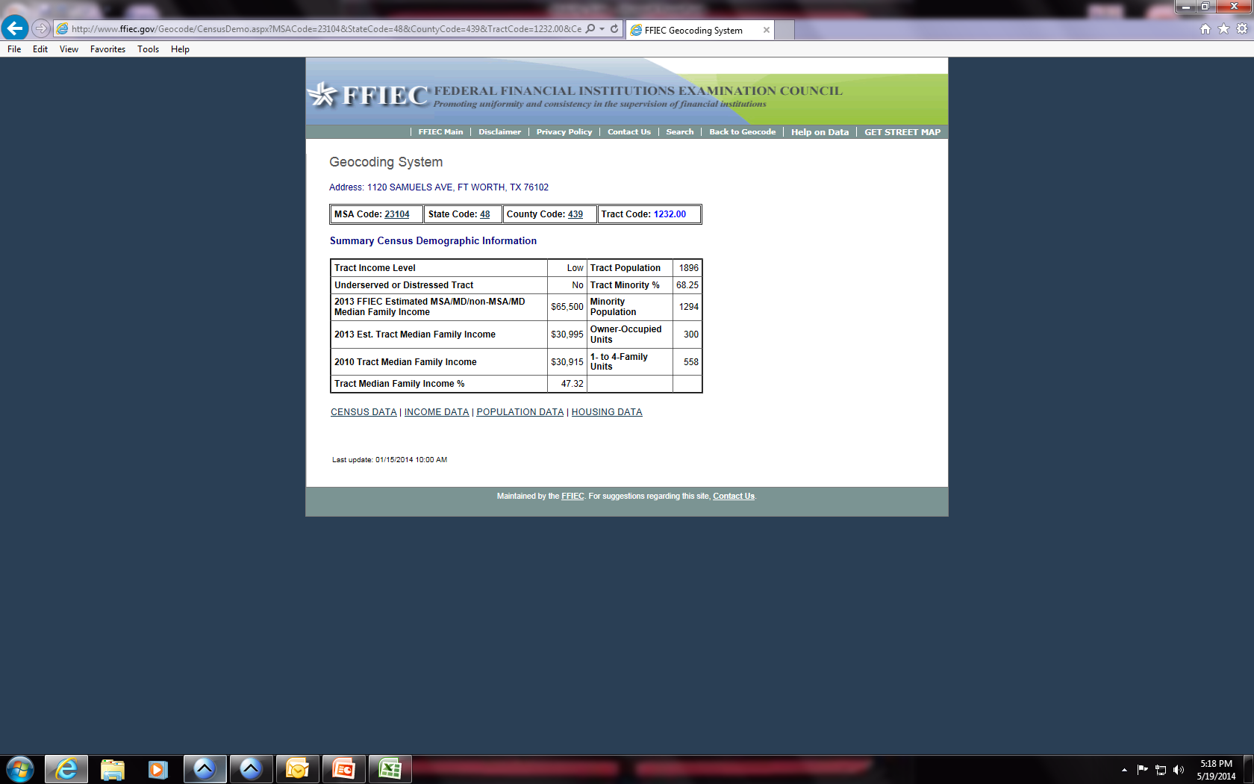
Note income level, then click INCOME DATA

Slide 65
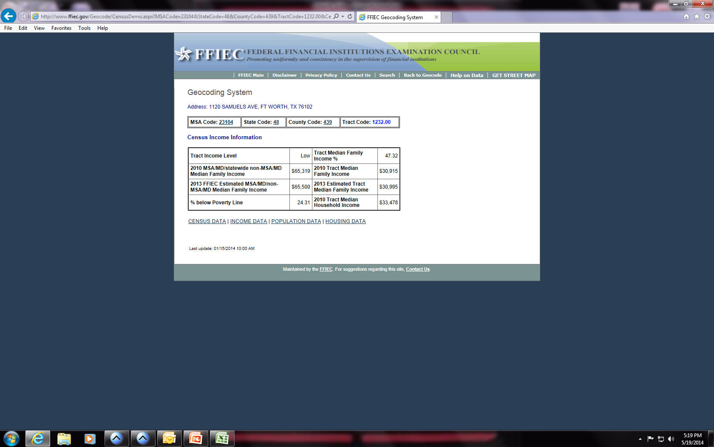

Slide 66

www.tea.state.tx.us for school ratings in your area

Slide 67

www.txschools.org

Slide 68
Things To Remember
You have 60 days after receiving your voucher to locate a unit
You are responsible for all security deposits and other fees.
Refer to the Payment Standard for FWHS, www.fwhs.org.
Utilities must be in Head of Household/Spouse’s name only.
Unit must pass Inspection before you move in.
You must abide by FWHS Standards & Rules.
Must comply with SEDACA policy .
You must pay your portion of rent (Total Tenant Payment) on time.
Notify FWHS of any changes within 10 days in writing.

Slide 69
Available Units
Landlord with Available Units
Deonte Thompson 512-815-3029
Nichelle Thrower 510-798-958
Jacob Asay 817-915-592
Paul Lorica 972-804-5710
Daniel Vega 732-423-7154
Danielle Tucker 817-301-4863
Please contact the landlord for the address and availability of each unit. Thanks!
FWHS Available Properties
Alton Park 817-720-8094
Cambridge Court 817-696-8080
Carlyle Crossing 817-423-2700
Matodor Ranch 817-568-9595
Western Center 817-984-1139
Stallion Point 682-990-3950

Slide 70
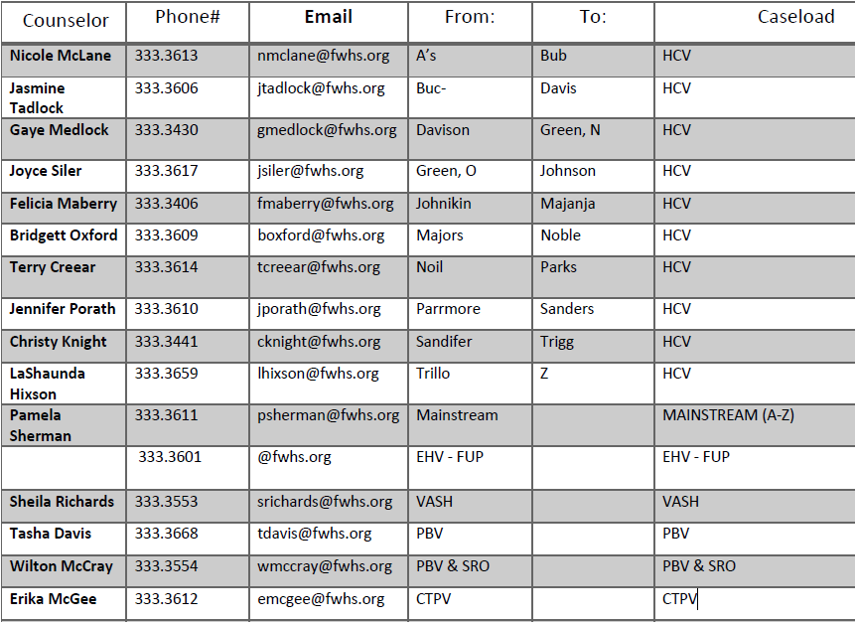
COUNSELOR CASELOAD
Please note the phone number begins with 817-333-xxxx
(Example: ph 817-333-3613)

Slide 71
Available Units

Slide 72

You have completed the online briefing!
Please screenshot this page.
We hope you enjoy your new home!

